Slide 1

Pediatric Psychopharmacology
The Good, the Bad, & the Ugly

Slide 2

From a Mother
“I recently saw an ad in a magazine for a drug called Vyvanse. The advertisement showed a mom and a kid trying to do homework. It said something like, “Is your child’s ADHD making homework difficult?”
“Then I read the side effects on the opposite page. There were many startling potential reactions to the drug — aggression, new abnormal thoughts/behaviors, mania, growth suppression, worsening of motion or verbal tics, and Tourette’s syndrome. It is also possible to start having ‘abnormal thought or visions’ as well as ‘hearing abnormal sounds.’

Slide 3
From a Mother
“The one that got me the most was this one — may affect your child’s ability to drive or do other dangerous activities.
“Maybe battling through homework isn’t as bad as your kid plowing through your living room on a forklift, lighting a stick of dynamite, all the while seeing things and hearing voices.”

Slide 4
Prologue
Some Orienting Facts & Assumptions

Slide 5

If You Are Considering Attending…
There remain a number of gaps in this Powerpoint® program, which I intend to fix by the presentation
There is material that I probably need to discard, as it is too detailed and esoteric
I need to get more specific concerning children and adolescents, differences between them an adults, and provide an indication which drugs should not be used with children/adolescents
I probably need some more pictures

Slide 6
Some General Assumptions
You already know some, or more than some, about what we’re talking about today
Some of you know more than I do, at least in some areas of this topic
You have forgotten some of the stuff you once knew, and there are some new things that most of you do not know
You are good-hearted people who will be willing to overlook some clumsiness on my part
Most of you will learn some things today you did not already know

Slide 7
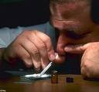


Introduction
Psychopharmacology is the study of the ways in which chemicals introduced from the outside of the body influence psychological functioning.
We assume that most such actions are mediated (at least in part) by the direct action of the drug on a neurological substrate
For simplicity, we will refer to all such chemicals as drugs, whether they are prescription (e.g., Lamictal), over-the-counter (e.g., phenylephrine), homeopathic/naturopathic (e.g., St. John’s wort), or illegal (non-prescription methamphetamine, hashish)

Slide 8
Pharmacodynamics
Pharmacodynamics focuses on the way in which drugs affect the body, especially, of course, brain functioning (e.g., the way in which cocaine produces dopaminergic activity in the nucleus accumbens – the brain’s principal “pleasure center”). In a word, pharmacodynamic analysis focuses on the mechanisms by which drugs change the activities of neural structures, which can in turn have lasting effect on the structure and life of the neuron.

Slide 9
Pharmacokinetics
Pharmacokinetics focuses on the way in which the body affects the drugs once they are in the body (e.g., the rate at which the drug is permitted to enter the bloodstream and the brain, the rate at which enzymes in the body break down the drug and excrete it, etc.). You could say that in pharmacokinetic analysis we are interested in the way that the body allows the drug to work and persist.

Slide 10

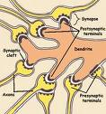
Neurons
  The working parts of the nervous system are made up of cells known as neurons (and their supportive cells – glia and microglia). Adult brains have about 100 million neurons and considerably more glial cells.
  Like (almost) all cells, neurons have a nucleus that contains virtually all of the body’s encoded genetic information (an important point).
  The genetic information tells the cell what proteins to make and assemble into working units, i.e., it determines what the cell will build and how it will work.
    Only a portion of the genetic information carried in any cell is active.

Slide 11
Three Kinds of Neurons
There are of course many kinds of neuron cells, but just three basic functions (and only two forms, really, at least for present purposes)
  Sensory (unipolar and bipolar) neurons
  Processing or decision-making (multipolar) neurons
  Motor (multipolar) neurons
The decision-making and (to a lesser extent) motor neurons are where the actions of the drugs we’re talking about produce their effects

Slide 12
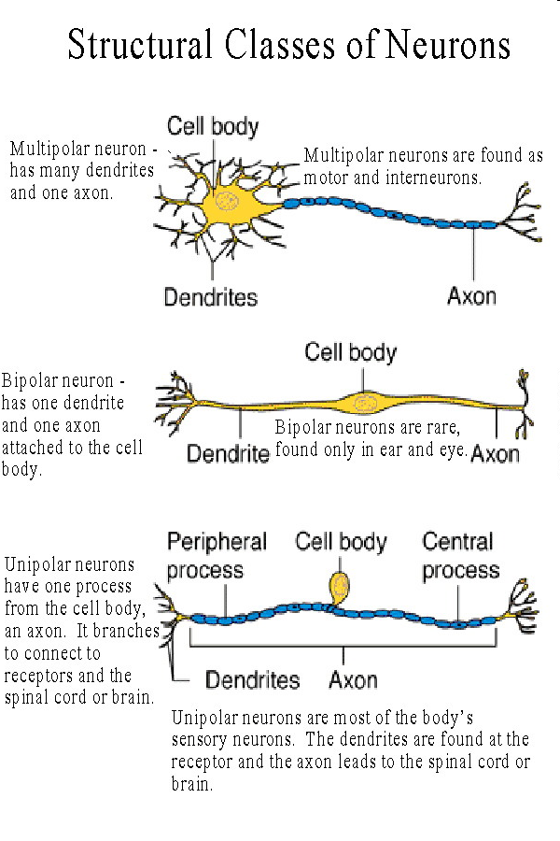
Three Kinds of Neurons

Slide 13
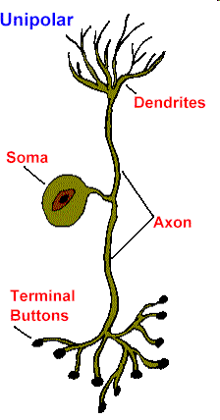
Sensory neurons…
Transduce energies from outside the body, or from within the body but outside the nervous system, into a bioelectric code, which they send to the central nervous system (brain & spinal cord).
PNS
CNS

Slide 14
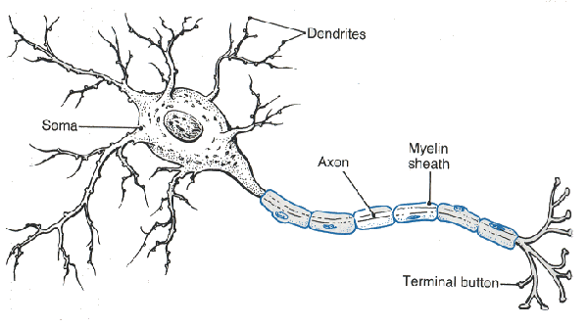
Multipolar Neurons…
Are in the brain and spinal cord, collecting information from sensory and other neurons with their “dendritic trees,” up to a thousand bits at a time.

Slide 15
Multipolar Neurons…
Collect information from other cells by way of chemicals released by those cells, a process called electrochemical coupling. The information may be excitatory (accelerating information flow) or inhibitory (inhibiting or stopping information flow).
neurotransmitters

Slide 16
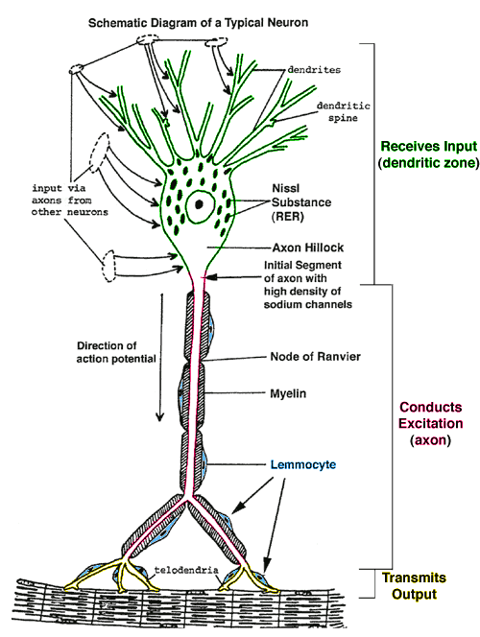
Multipolar Neurons…
Summate the multiple inputs received from other cells (excitatory & inhibitory) at the axon hillock, transferring the information through the axon to other cells by electrochemical coupling (synaptic transmission).

Slide 17
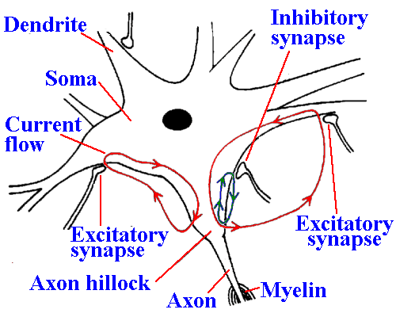
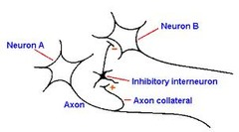
A Ballad of Just 3 Neurons
C
Neuron C receives excitatory information from Neuron A, and inhibitory information from neuron B. In effect, neuron C weighs the relative strengths of A’s saying “Go ahead & fire,” & B’s saying, “Inhibit that, dude!” and “decides” at the axon hillock whether to fire, and if so, how fast.
B
A
Now, imagine that same neuron receiving a cascade over space & time of excitatory & inhibitory messages, summating them all, and “deciding” to fire or not. Short-term neural decision making is just a bunch of simple messages added up!

Slide 18

Amateur Animation
Another presynaptic neuron
Action potential
COMT
Presynaptic Neuron
Enzymatic
Neutralization
Action potential
MAO
Postsynaptic Neuron
NT
Presynaptic
Reuptake
Conductance Changes
IPSP
second messenger
EPSP
First messenger
Orange = Metabolically active NT neutralization mechanisms
EPSP = excitation
IPSP = inhibition
Two presynaptic neurons, one excitatory on the postsynaptic neuron, and the other inhibitory.
Notes:
10/1/2014
18

Slide 19

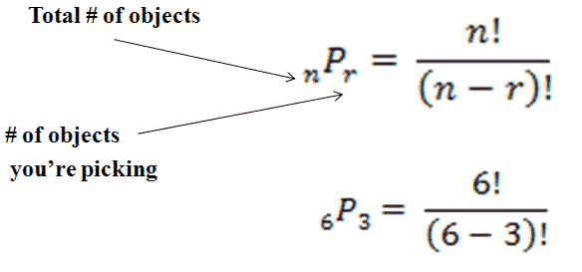
A Ballad of 1001 neurons
You do the math: 100,000 neurons, each receiving up to 1000 bits of information at once – lots of possibilities.
_{n}P_{r} = (100,000!)/(100,000 – 1000)! = 10⁵!/(9.9 * 10⁴)!
And this is just if each neuron is receiving the full 1000 inputs. If less, the story is different (more possibilities).

Slide 20
First Takeaway Point
Information is transferred from cell to cell in a neuron by electrochemical coupling or synaptic transmission
Most psychoactive drugs alter that process, and they thus change the information transferred – they alter the message)
The purpose of psychoactive drugs is to alter the message in specific ways,
(Though often there is a cost in altering other, often unrelated messages in undesired ways).

Slide 21

Synapsing in a Pharmacologically relevant View

Slide 22
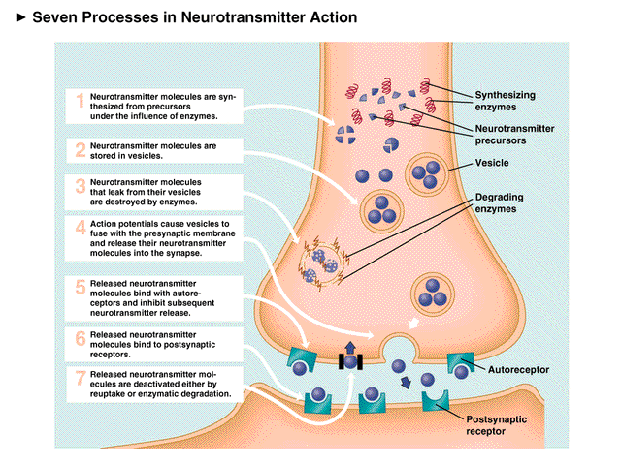
Synaptic Transmission
Neuron to Neuron & Neuron to Motor Cell
(Glands and Muscles)

Slide 23
Eccles’ Lock and Key Model
Sir John Eccles has suggested that we can think of the neurotransmitter that opens the protein lock in the next cell as a chemical key, uniquely conformed to fit into the chemical receptor (lock) on the receiving cell. His model has of course been expanded and detailed since, but it still has metaphorical worth.
spike potential reaches axon end
presynaptic neuron
NT exits the presynaptic cell
neurotransmitter (e.g., serotonin), the first messenger (the “key”)
synaptic receptor site (the lock)
postsynaptic neuron

Slide 24
Eccles’ Lock and Key Model
The key fits into the lock because chemically it can.
G protein-based receptors are one kind of lock.
spike potential reaches axon end
presynaptic neuron
NT attaches loosely to the receptor site on the presynaptic cell
neurotransmitter (e.g., serotonin), the first messenger (the “key”)
synaptic receptor site (the “lock”)
postsynaptic neuron

Slide 25
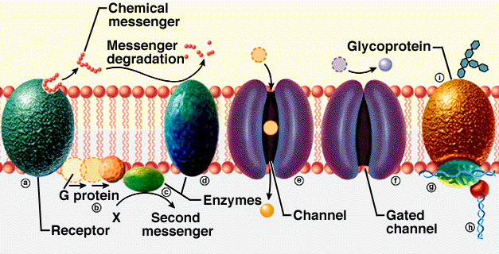
G Protein-Linked Receptors
These neurotransitters (NT) have G protein-linked receptors
  Dopamine (DA)
  Norepinephrine (NE)
  Serotonin (5HT)
  Gamma-amino butyric acid (GABA), at GABA-B receptors
  Glutamate (metabotropic, i.e., these do not act through direct changes in ion channels, but rather indirectly through enzymatic actions ultimately affecting ion channels and other facets of neuronal action)
  Histamine
  Acetylcholine (muscarinic)
G protein-linked receptors are complex proteins embedded in the post-synaptic membrane. They are chemically activated by the first messenger (NT), then changing the conformation of a conjoined G protein. The G protein can then connect to and activate an enzyme (e.g., adenylate cyclase) which in turn activates a second messenger (e.g., cyclic AMP or inositol 1,4,5 triphospate). The second activates a third messenger (e.g., a kinase), which acts back on the membrane and downstream on the genome through third, fourth, and fifth messengers.

Slide 26
Eccles’ Lock and Key Model
The key fits into the lock because chemically it can.
Ligand-gated ion channels are another kind of lock (receptor), AKA ionotropic or ion channel-linked receptors.
spike potential reaches axon end
presynaptic neuron
NT attaches loosely to the receptor site on the presynaptic cell
neurotransmitter (e.g., GABA), the first messenger (the “key”)
Ionotropic synaptic receptor site (the “lock”)
postsynaptic neuron

Slide 27
Eccles’ Lock and Key Model
The key fits into the lock because chemically it can.
Ligand-gated ion channels are another kind of lock (receptor), AKA ionotropic or ion channel-linked receptors.
spike potential reaches axon end
–
presynaptic neuron
NT attaches loosely to the receptor site on the presynaptic cell
Neurotransmitter (e.g., GABA), the first messenger (the “key”) binds to a site on the ionotropic receptor, allowing ions of a particular species (e.g., chloride or Cl–) to flow into the cell.
–
–
Ionotropic synaptic receptor site (the “lock”)
–
–
postsynaptic neuron
–
–
–

Slide 28
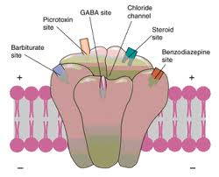
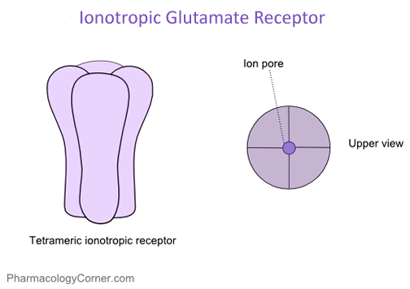
Ligand-Gated Receptors
These receptors, also proteins in the membrane, are ligand-gated (chemically activated) ion channels that are opened or closed when a neurotransmitter (ligand) occupies receptor sites on its surface:
  Serotonin (5HT₃)
  Gamma-amino butyric acid (GABA), at GABA-A receptors
  Glutamate (ionotropic, i.e., these receptors act by changing the rate at which specific ions can pass through the membrane)
  Acetylcholine (nicotinic)
Ligand-gated receptors generally produce more immediate reactions than do G protein-linked receptors

Slide 29
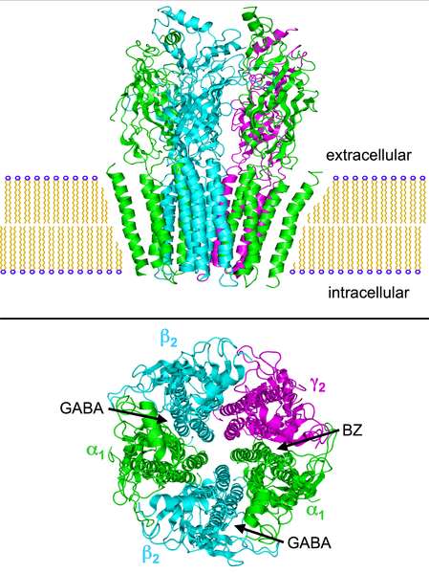
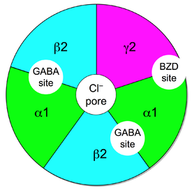
GABA
Ionotropic Receptor
Illustrations from Wikipedia, http://en.wikipedia.org/wiki/GABAA_receptor

Slide 30
Important Factoid
DA=dopamine
NE=norepinephrine
5HT=serotonin
GABA=γ-amino-butyric acid
Glu=glutamine
Gly=glycine
ACh=acetylcholine
nACh=nicotininc cholinergic receptor
HA=histamine
Receptors for a given neurotransmitter occur in multiple forms, e.g., DA₁ and DA₂, ACh_{M1}, nACh_{α2β4} ,receptors, etc., which are molecularly different.
Different receptor types typically carry out different functions.
The naturally occurring neurotransmitter occupies and activates all its receptors, but drugs that have an affinity for those receptors are more selective.
Typically this is a good thing

Slide 31
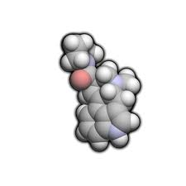
An Important and Complicating Factor
As noted receptor proteins that are responsive to a given neurotransmitter occur in multiple forms. In that sense they are substrates for different functions and different drugs.
Some receptor forms are autoreceptors, i.e., they respond to the neurotransmitters that they themselves release. Since many CNS neurotransmitters are inhibitory, these autoreceptors can be of some importance as a part of a negative feedback loop.
(The other receptors are called heteroreceptors.)
Notes:
10/1/2014
31

Slide 32
An Important and Complicating Factor
Autoreceptors may be presynaptic or postsynaptic
Regardless they tend to inhibit firing in neurons that release the same neurotransmitter they respond to.
Like other forms of multiple receptor types, autoreceptors may be differentially responsive to different exogenous drugs.
  Lysergic acid diethylamide – 25 (LSD-25), for example, is a selective agonist for serotonin autoreceptors. It mimics the actions of serotonin on autoreceptors but not so much on heteroreceptors.
Notes:
10/1/2014
32

Slide 33
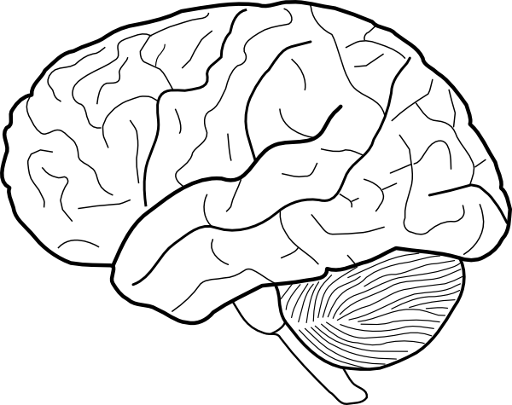
Inhibitory & Excitatory Links
A loop that normally inhibits psychotic expression
Glu
GABA
DA

Slide 34

Excitatory Links
A loop that facilitates effective executive function
Glu
Glu
DA

Slide 35
autoreceptor Function
Brainstem Norepinephrine Center (Locus Coeruleus)
NE
NE heteroreceptor
NE
NE autoreceptor
5HT
Brainstem Serotonin Center (Raphé)
The basic mechanism of mirtazapine (Remeron), an alpha 2 blocker (and antidepressant), is to block NE₂ receptors.

Slide 36
The Ways Psychoactive Drugs WOrk
A Layperson’s Understanding

Slide 37
General Ideas
Roughly 90% of commercially available psychoactive drugs operate at basic synaptic mechanisms
  60% have an effect on the action of the normal transmitter – mimicking or enhancing it in some measure, or blocking it, or both! (depending on baseline conditions)
  30% have an effect on the mechanisms by which neurotransmitters are neutralized after they are released
  The rest are more complex, and we will discuss them we come to them

Slide 38
Agonists, Blockers, & Partial Agonists
The 60%

Slide 39
Agonism
Mimicking the Actions of the Normal Neurotransmitter

Slide 40
The Lock and Key Model: Agonism
Some agents from outside the body (drugs) can serve as “skeleton keys” at some receptor sites, occupying the receptor because they are similar enough to the natural NT molecularly.
spike potential reaches axon end
presynaptic neuron
NT exits the presynaptic cell
drug (skeleton key), e.g., guanfacine
neurotransmitter (e.g., dopamine), the first messenger (the “key”)
synaptic receptor site (the lock)
postsynaptic neuron

Slide 41
Eccles’ Lock and Key Model: Drugs
“Skeleton keys” are direct agonists: They occupy the receptor site and turn the tumblers, i.e., they mimic the actions of the naturally occurring NT. They enhance the effects of the NT.
spike potential reaches axon end
presynaptic neuron
NT exits the presynaptic cell
drug (skeleton key), e.g., guanfacine (Intuniv)
neurotransmitter (e.g., dopamine), the first messenger (the “key”)
synaptic receptor site (the lock)
postsynaptic neuron

Slide 42
Agonism
When a drug mimics or intensifies the effects of a naturally occurring neurotransmitter at a specific receptor site, it is an agonist (and the process is agonism)
More specifically, this is direct agonism, since it has a direct physiologic effect on the receptor – specifically, the receptor is the substrate for the drug
Example: clonidine (Catapres) and guanfacine (Tenex, Intuniv) are agonists at α_{2A} autoreceptors (which inhibits sympathetic arousal, lowering blood pressure, facilitating relaxation and sleep, and facilitating attentional mechanisms in the prefrontal cortex.
α & β receptors are two different kinds of NE receptors
Notes:
10/1/2014
42

Slide 43
Agonism:
Clumsy But Informative Model
Normal Action of NT
Action of Agonistic Drug
Receptor Sites

Slide 44
Antagonists
Okay, Blockers, if You Prefer

Slide 45
Eccles’ Lock and Key Model: Drugs
Some other agents from outside the body (also drugs) can occupy the receptor sites on the postsynaptic cell but cannot turn the tumblers. They are called antagonists, and they block the actions of the naturally occurring NT (which does not have as many receptor sites to occupy, and thus has its normal action slowed or blocked.
spike potential reaches axon end
presynaptic neuron
NT exits the presynaptic cell
drug (antagonist), e.g., Haldol
neurotransmitter (e.g., dopamine), the first messenger (the “key”)
synaptic receptor site (the lock)
postsynaptic neuron

Slide 46
Eccles’ Lock and Key Model: Drugs
Antagonists occupy the lock, keeping the key from entering, and they do not turn the tumblers, since their molecular structure does not share key elements with that of the normally occurring NT.
spike potential reaches axon end
presynaptic neuron
NT exits the presynaptic cell
drug (antagonist), e.g., Haldol
neurotransmitter (e.g., dopamine), the first messenger (the “key”)
synaptic receptor site (the lock)
postsynaptic neuron

Slide 47
(Silent) Antagonism
When a drug blocks the action of a normally occurring neurotransmitter by competing for available receptor sites
Antagonists typically occupy the receptor sites without duplicating the effects (or producing any effect whatsoever, apart from getting in the way of other active agents, while blocking access to the normally occurring neurotransmitter
If there is no agonist active, there will be no observable effect of the antagonist: It will be “silent,” not even interfering with “constitutive” activity in the receptors.
Example: All classical antipsychotic drugs antagonize D₂ receptors, which produces the antipsychotic effect and the typical side effects (extrapyramidal syndrome, tardive dyskinesia)
Notes:
10/1/2014
47

Slide 48
Model of (Silent) Antagonism
Receptor Blockade By
Antagonistic
Drug
Normal Action of NT
Receptor Sites

Slide 49
Partial Agonism
One Big Piece of the Future

Slide 50
Eccles’ Lock and Key Model: Drugs
Some agents from outside the body (drugs) can serve as partial agonists at some receptor sites, occupying the receptor because they are similar enough to the natural NT molecularly. Partial agonists mimic the effects of the NT, but in a way that is weaker than the NT. If the NT is active, a partial agonist interferes with its action at receptors and lowers activity. If the NT is not active, the partial agonist will increase activity. Abilify (aripiprazole) does this at dopamine receptors.
spike potential reaches axon end
presynaptic neuron
NT exits the presynaptic cell
drug (skeleton key), e.g., Abilify
neurotransmitter (e.g., dopamine), the first messenger (the “key”)
synaptic receptor site (the lock)
postsynaptic neuron

Slide 51
Eccles’ Lock and Key Model: Drugs
Some agents from outside the body (drugs) can serve as partial agonists at some receptor sites, occupying the receptor because they are similar enough to the natural NT molecularly. Partial agonists mimic the effects of the NT, but in a way that is weaker than the NT. If the NT is active, a partial agonist interferes with its action at receptors and lowers activity. If the NT is not active, the partial agonist will increase activity. Abilify does this at dopamine receptors.
spike potential reaches axon end
presynaptic neuron
NT exits the presynaptic cell
drug (skeleton key), e.g., Abilify
neurotransmitter (e.g., dopamine), the first messenger (the “key”)
synaptic receptor site (the lock)
postsynaptic neuron

Slide 52
Partial Agonism
When a drug occupies the receptor sites, activating them, but producing a weaker response than the neurotransmitter or a full agonist does, it is a partial agonist
In low concentrations of the NT the partial agonist works as an agonist
In high concentrations of the NT the partial agonist works as an antagonist
Example: Aripiprazole (Abilify) is a partial dopamine agonist, in schizophrenia (& other psychotic disorders) dampening excessive DA₂ activity in the limbic striatum, and enhancing DA₂ activity in the prefrontal cortex.

Slide 53
Partial Agonism 1
Normal or Weak Action of NT
Partial agonist occupying additional receptor sites and mimicking the NT, thus enhancing its effect
Receptor Sites
The partial agonist occupies many unoccupied receptor sites, strengthening the activity in the understimulated receptors.

Slide 54
Partial Agonism 2
Partial Agonist
Partial Agonist
The partial agonist gets in the way of the normal neurotransmitter’s occupying the receptors, and because of its weaker action the partial agonist slows down receptor activity
Excessive Action of NT
Receptor Sites

Slide 55
Reuptake Inhibitors
The 30%

Slide 56
Neurotransmitter Reuptake
Most neurotransmitters are neutralized by reuptake mechanisms
These are simply specialized proteins in the membrane of the releasing cell that use metabolic energy to “capture” released neurotransmitters and carry them back into the cell, where they are repackaged for future release
Some drugs work by interfering with these mechanisms and allowing the neurotransmitter in the space between cells to build to larger than “normal levels”
Blocking reuptake can produce desirable and undesirable psychological effects

Slide 57
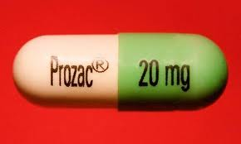
Presynaptic Reuptake: Dopamine, Norepinephrine, & Serotonin
  The monoamine transporters “capture” molecules of their respective substrates of dopamine, norepinephrine, and serotonin which have been jettisoned into the extracellular space at the synaptic cleft from inside the cell.
  The monoamine transporters come in three forms: the dopamine transporter (DAT). The norepinephrine transporter (NET), and the serotonin transporter (SERT). Numerous important drugs interfere with one or more of these transporters.

Slide 58

Other Presynaptic reuptake mechanisms
Presynaptic reuptake mechanisms are relevant to the functioning of many other neurotransmitter systems, but those for the monoamines (dopamine, norepinephrine, and serotonin) are currently by far the most relevant to our task
For now sort of

Slide 59
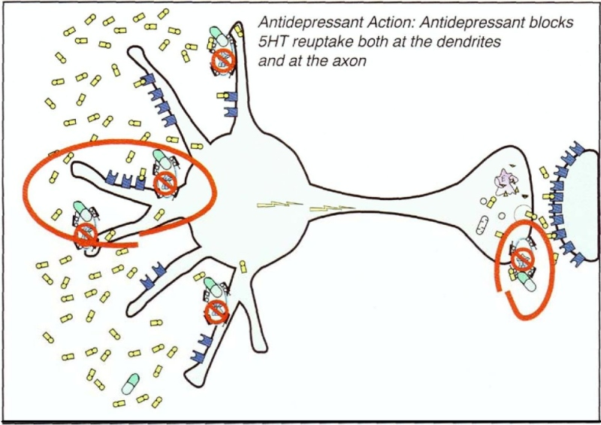
The Beginning of SSRI Treatment
(S.M. Stahl)

Slide 60
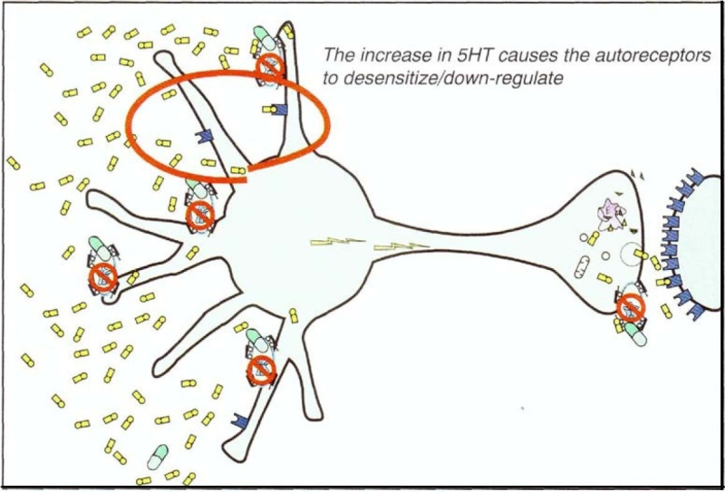
After a Period of SSRI Treatment
(S.M. Stahl)

Slide 61
Important Brain Structures in Pschopharmacology
The Substrate of Drug Action Mostly in Pictures

Slide 62
The Prefrontal Cortex & Relevant Circuits
Of greatest (but not exclusive) importance in psychopharmacology is the prefrontal cortex (PFC) of the frontal lobe.
fMRI studies suggest that discrete areas of the PFC mediate higher cognitive and emotional functions
Those areas are connected to subcortical regions that participate in the regulation and fine tuning of the functional PFC
  These loops generally send cortical output to the striatum, then to the thalamus, and back to the cortex – CSTC loops
  Each structure in the loop is regulated by brainstem neurotransmitter centers (DA, NE, 5HT)

Slide 63
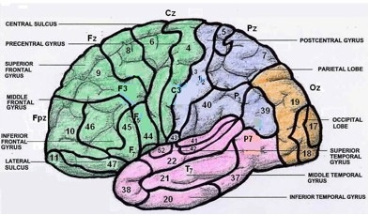
Dorsolateral Prefrontal Cortex
Executive functions, problem solving, analysis (possible aspects of fluid reasoning – Gf)
Generally mediated in Brodmann’s area 9

Slide 64
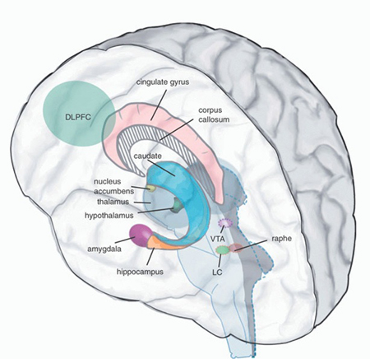
CSTC: Dorsolateral Prefrontal Cortex & Executive Function
Output from the DLPFC is relayed to the upper dorsal caudate in the striatum, to the thalamus, and from there back to the DLPFC.
All three sites are influenced by the monoamines, acetylcholine, and histamine from the brainstem.

Slide 65
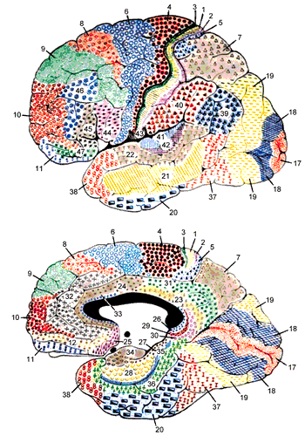
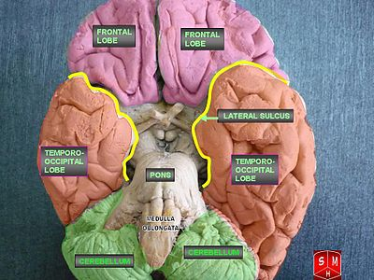
Orbito-frontal Cortex
Above the orbit of the eye, this structure appears to facilitate impulse control (perhaps through judgments concerning outcomes of actions – anticipation of rewards and punishments), to regulate biological and derived motives, and may regulate compulsive behavior.
It is generally Brodmann’s area 11

Slide 66
CSTC: Orbito-frontal Cortex & Impulsivity/Compulsivity
Output from the orbito-frontal cortex is relayed to the ventral caudate in the striatum, to the thalamus, and from there back to the orbito-frontal cortex.
All three sites are influenced by the monoamines, acetylcholine, and histamine from the brainstem.
Orbito-frontal Cortex

Slide 67
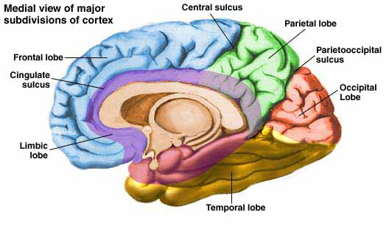
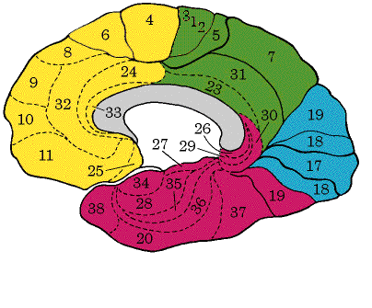
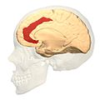
Anterior Cingulate Cortex
Located in the anterior cingulate gyrus (Brodmann’s areas 23, 24, and 30), this area has two distinct functions:
  The dorsal portion of the ACC (Brodmann’s area 32) is apparently involved in selective attention (e.g., in the Stroop task)
  The ventral portion of the ACC (also called the subgenual ACC – Brodmann’s area 24) appears to regulate affect, especially depression and anxiety

Slide 68
CSTC: Dorsal ACC & Selective Attention
Output from the dorsal ACC is relayed to the ventral caudate in the striatum, to the thalamus, and from there back to the dorsal ACC.
All three sites are influenced by the monoamines, acetylcholine, and histamine from the brainstem.

Slide 69
CSTC: Ventral (Subgenual) ACC &
Ventromedial PFC Regulation of Affect
Output from the ventral ACC and orbito-cortical PFC is relayed to the nucleus accumbens near the striatum, to the thalamus, and from there back to the ventral ACC.
All three sites are influenced by the monoamines, acetylcholine, and histamine from the brainstem.

Slide 70
CSTC Circuits: Take-away Point
These circuits are regulated and fine-tuned from “down under,” the brainstem monoamine, cholinergic, and histaminic neurotransmitter pathways.
Cortical neurons excite through glutamate release and they are inhibited by surrounding GABAergic releasing neurons.
Just so: these neurotransmitters are those whose actions are affected by the bulk of psychopharmacological agents now in common use.

Slide 71
Specific Drug Classes & How They Work
Mechanisms, Actions, Adverse Effects, and Special Considerations for Children & Adolescents

Slide 72
Attention-Deficit/ Hyperactivity Disorder
Let’s Start With Something Simple

Slide 73
Characteristics of ADHD:
A Quick Reminder
Maladaptive, age inappropriate inattention
    Careless of detail
    Poorly sustained attention in tasks or play
    Doesn’t seem to listen to direct communication
    Fails to follow through on instructions
    Difficulty organizing tasks and activities
    Avoids, dislikes, or is reluctant to enter tasks requiring sustained mental effort
    Loses things necessary for tasks or activities
    Easily distracted by extraneous stimuli
    Forgetful in daily activities

Slide 74
Characteristics of ADHD:
A Quick Reminder
Maladaptive, age inappropriate hyperactivity-impulsivity
    Fidgets with hands or feet or squirms in seat
    Leaves seat when remaining seated is expected
    Inappropriate excessive running or climbing (subjective restlessness in adults)
    Difficulty with playing or doing leisure activities quietly
    “On the go” or as if “driven by a motor”
    Talks excessively
    Impulsivity
        Blurts out answers before questions are completed
        Has difficulty awaiting turn
        Interrupts or intrudes on others

Slide 75
May I suggest…
That these difficulties are the quintessential characteristics of being out of attunement in the prefrontal cortex:
  Inadequate executive functioning
  Impulsivity
  Motor excess
In general, this inference suggests underarousal coupled with disinhibition (in effect, underarousal of inhibitory systems)

Slide 76
Putative Neural Bases of ADHD
The symptoms of ADHD, which can vary in measure somewhat independently, appear in the classic view to be based in underarousal of the prefrontal cortex – presumably owing to reduced stimulation of DA₁ receptors in the prefrontal cortex by brainstem mesocortical dopaminergic pathways.
In general, ADHD is a hypo-arousal disorder focused in the dorsolateral prefrontal cortex (sustaining attention, planning, & cognitive flexibility), the dorsal anterior cingulate cortex (selective attention/ adequate information processing), and perhaps the orbitofrontal cortex (impulsivity)

Slide 77
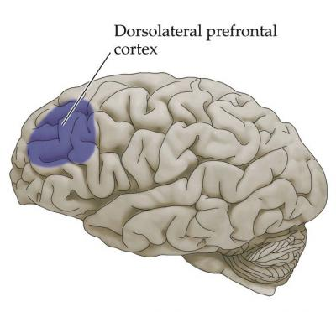
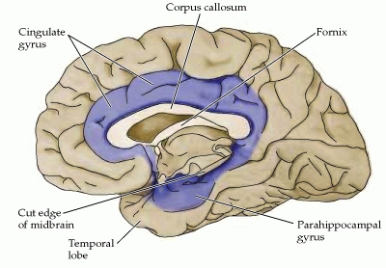
Dorsal anterior cingulate
Orbitofrontal cortex

Slide 78
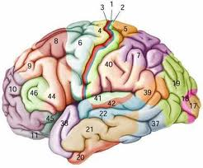
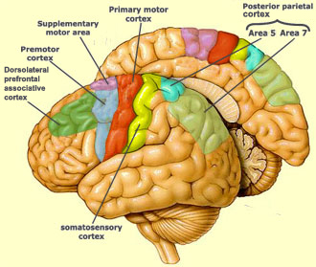
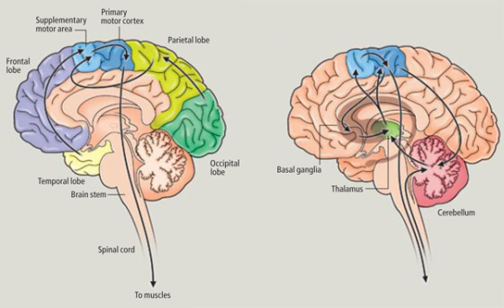
Putative Neural Basis of Hyperactivity
Disturbances in the regulation of motor activity (i.e., hyperactivity) appear to result from failure of dopaminergic and other pathways to control motor output from the premotor and supplementary motor areas. The normal control is presumably mediated by dopaminergic nigrostriatal pathways to the striatum, with relays to the neocortex.

Slide 79
Wanna Ramp Up The Prefrontal Cortex? Stimulant Drugs Work Well
Drugs that directly or indirectly increase activity in the PFC are stimulant drugs
With the exception of a few other approaches these drugs are well a well established means of regulating ADHD symptoms
Pharmacokinetics to ensure non-pulsatile influx to the brain are now more important than pharmacodynamics

Slide 80
ADHD Stimulant Medication: Pharmacokinetic Control of Abuse Potential
In these drugs, the newer innovations focus on how the body delivers and metabolizes stimulant drugs (pharmacokinetics) not so much any longer the way the drugs affect the brain (pharmacodynamics).
  Concerta is an extended release methylphenidate.
  Focalin is a more potent enantiomer (one of two mirror images of the molecule) of methylphenidate (dextro-methylphenidate). It also comes in extended release form.
  Daytrana patches deliver methylphenidate through the skin.
  Vyvanse is a prodrug, which is metabolized in the body into dextroamphetamine.
  Adderall is a combination of two salts each of amphetamine and dextroamphetamine, which allows for a more controlled release into the brain. In addition it comes in an extended release form.
Notes:
10/1/2014
80

Slide 81
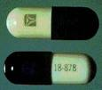
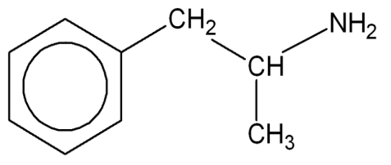

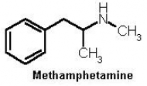



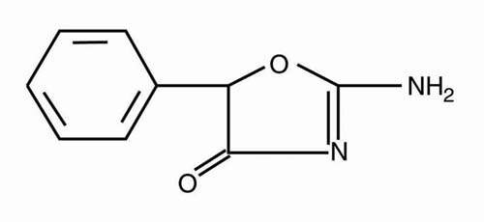

ADHD Medication
Stimulants
  Biphetamine (amphetamine resin complex)
  Desoxyn (methamphetamine)
  Dexadrine (dextroamphetamine)
  Ritalin, Concerta (methylphenidate)
  Adderall (amphetamine + dextroamphetamine)
  Cylert (magnesium pemoline)
Notes:
10/1/2014
81

Slide 82
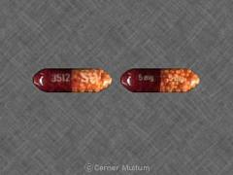
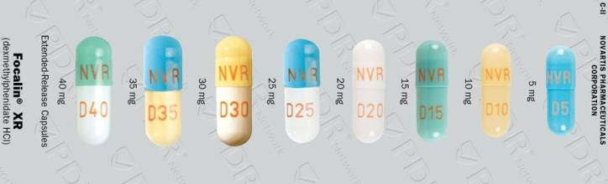
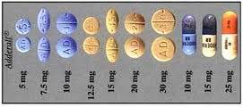

ADHD Medication
Stimulants
  Biphetamine (amphetamine resin complex)
  Dexadrine (dextroamphetamine)
  Desoxyn (methamphetamine)
  Ritalin, Concerta (methylphenidate)
  Focalin (dextromethylphenidate)
  Adderall (amphetamine + dextroamphetamine)
  Cylert (magnesium pemoline)
Notes:
10/1/2014
82

Slide 83
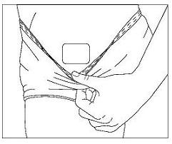
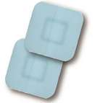
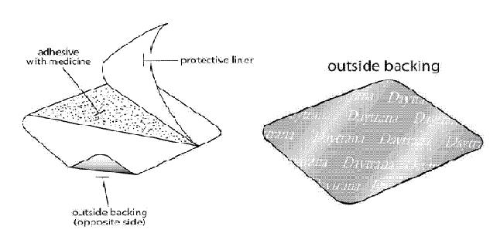
Tricks of the ADHD Trade:
Daytrana Patch

Slide 84
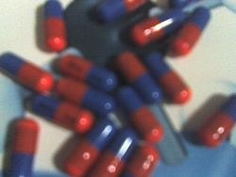
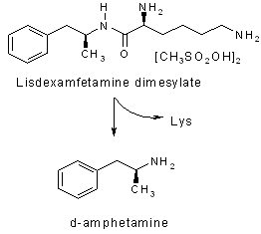
Vyvanse (lisdexamfetamine/
_{L}-lysine-d-amphetamine)
A prodrug (must be ingested to act effectively): It is transformed into an active form of the drug by the actions of the body’s enzymes on it. Vyvanse is converted to dextroamphetamine in the body.
Can be taken in the morning.
Notes:
10/1/2014
84

Slide 85

Love me some prodrugs, dude!

Slide 86
Stimulant Side Effects
Reduced growth rate in some children and adolescents.
Occasional increases in anger and aggression.
Difficulty in going to sleep.
Psychological addiction (but usually not in people with ADHD – most anyone else for that matter).
Cylert may produce toxicity in the liver, which can be fatal.
And remember, in strong and rapid pulsatile dosages, the stimulants block the reuptake of norepinephrine and dopamine (including in the nucleus accumbens, producing a rush of pleasure and the potential for addiction)

Slide 87
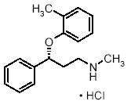

ADHD Medication: A Non-Stimulant
Norepinephrine reuptake blocker
  Strattera (atomoxetine HCl)
  Unlike stimulants (which can be abused in some forms), Strattera is not a controlled substance.
  Like the stimulants, or any drug that facilitates available norepinephrine, it sometimes increases anger and aggression
Notes:
10/1/2014
87

Slide 88
Special Considerations with Children & Adolescents

Slide 89
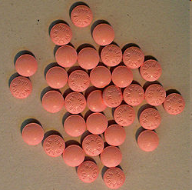
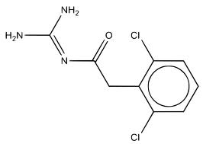
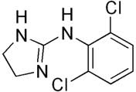
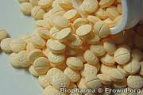
α_{2A} Agonists: Guanfacine (Tenex)
& Clonidine (Catapres)
Guanfacine is an adrenergic (NE) agonist that occupies postsynaptic receptors in prefrontal cortex (for ADHD), and CNS α_{2a} autoreceptors to reduce sympathetic outflow (reduces blood pressure).
The important effect from the standpoint of this class is the agonism of heteroreceptors in the prefrontal cortex
Clonidine (Catapres, Dixarit) has a similar action, but it is more general, occupying not only α_{2a} receptors but also other receptors, which may produce more side effects
  Constipation, dry mouth, light-headedness, hypotension

Slide 90
Anti-Anxiety Drugs
An Emotional & Cognitive Complex

Slide 91
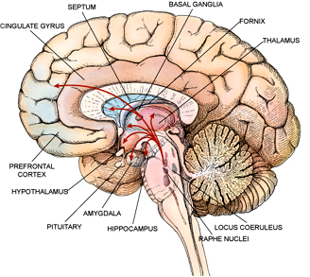

A Negligibly Non-Neural Model of Fear & Anxiety
hippocampal formation
anterior cingulate
amygdala
low road
fear output: hypothalamus, periacquductal gray, parabrachial nuclei, locus coeruleus,
nucleus accumbens
events
Bed nucleus of the stria terminalis
thalamus
high road
entorhinal cortex
insula
You fill in the phenomenology, okay… ‘ cause it’s there
orbito-frontal and ventromedial PFC
neocortex
& cognition

Slide 92
Focal Components of Anxiety from A Psychiatric Perspective
Core Affective (phasic): Fear/Anxiety/ Panic
  Irritability
Core Cognitive (tonic): Worry/rumination
  Concentration
  Obsessions and compulsions
Many of these pieces are present in all the anxiety disorders, as well as other disorders with anxious features
Secondary Somatic
  Fatigue
  Sleep disturbances
  Muscle tension
  Arousal
Secondary Behavioral
  Avoidance

Slide 93


Slide 94



Medications for the Treatment of Anxiety and Fear
Anxiety is mediated by a number of brain structures, and it can be interrupted by different medications.
The amygdala is a central controlling structure, which sends axons to structures controlling the phenomenological experience of fear (anterior cingulate and orbitofrontal cortex), motor avoidance (periaqueductal gray), endocrine and emotional reflexes (hypothalamus), and respiration (parabrachial nuclei).
Anterior cingulate gyrus
Orbitofrontal cortex

Slide 95
Controlling Anxiety Pharmacologically: Brain Structures & Meds
Benzodiazepine-sensitive GABA-A receptors
  Benzodiazepines as a class of drugs [are positive allosteric modulators, and in that role they] enhance the opening of ligand-gated (and inhibitory) chloride channels, inhibiting anxiety
When inhibited, 5HT_{1A} receptors in the amygdaloid complex reduce firing in their neurons and thus inhibit anxiety (inhibiting the inhibitors).
Noradrenaline also activates amgydaloid fear structures and the other brain structures that it innervates in anxiety/fear. Logically then, NE antagonists should help to curb fear

Slide 96











Anti-Anxiety Medications (Anxiolytics)
GABA agonists: Benzodiazepines
  Librium (chlordiazepoxide)
  Valium (diazepam)
  Xanax (alprazolam, a triazolobenzodiazepine)
  Ativan (lorazepam)
  Tranxene (clorazepate)
  And more
Notes:
10/2/2014
96

Slide 97
Anti-Anxiety Medications (Anxiolytics)
Common side effects of GABA agonists
  Sedation
  Dizziness
  Poor coordination
  Lowered libido
  Disinhibition
  Cognitive problems
  Addiction, tolerance, and withdrawal
Benzodiazepines open chloride channels in GABA_{A} receptors on postsynaptic neurons, allowing excess chloride to enter the cell and reduce neuron excitability. They are thus also effective in managing seizure disorders.
Notes:
10/2/2014
97

Slide 98




Anti-Anxiety Medications (Anxiolytics)
Serotonin and anxiety
  SSRIs, as noted above, are effective in controlling panic, social anxiety, generalized anxiety disorder, obsessive-compulsive disorder, and the like
  The 5-HT_{1A} partial agonist buspirone (Buspar) is an effective general control for anxiety.
    A similarly acting agent, gepirone ER (Ariza, Veriza) is in development.
Notes:
10/2/2014
98

Slide 99


Anti-Anxiety Medications (Anxiolytics)
Norepinephrine and anxiety
  Some patients with anxiety respond favorably to NE antagonists for alpha 1 and beta 2 norepinephrine receptors (alpha 1 adrenergic blockers and beta blockers respectively), suggesting, as intimated by functional neuroanatomy, that norepinephrine plays a role in activating the symptoms of anxiety.
Propranolol, a beta blocker
Notes:
10/2/2014
99

Slide 100
Special Considerations with Children & Adolescents

Slide 101
Antidepressants

Slide 102
A Quick Look at Depression
in a two-week period and representing a change from previous functioning, the person experiences either depressed mood or anhedonia. Symptoms may entail increased negative affect, INA, or decreased positive affect, DPA)
  Depressed mood most of the day most days, measured by self-report or objective behavior DPA/ INA
  Markedly diminished interest or pleasure in all, or almost all, activities most of the day most days (self-report or objective behavior) DPA
  Significant unplanned or unexpected weight loss, or decreased or increased appetite most days
  Insomnia or hypersomnia most days (INA?)
  Objective psychomotor agitation (INA) or retardation (DPA) most days
  Fatigue or loss of energy most days DPA
  Feelings of worthless or excessive or inappropriate guilt most days INA
  Diminished ability to think or concentrate, or indecisiveness, most days
  Recurrent thoughts of death or suicide without plan), or a specific plan or attempt INA

Slide 103

The Monoamine Hypothesis and Depression

Slide 104
Monoamines & Depressive Symptoms
  In general, lowered availability of serotonin is associated with increased negative affect depressed mood, guilt/disgust, fear/anxiety, hostility, irritability, “feelings of loneliness.”
  In general, lowered availability of dopamine is associated with decreased positive affect depressed mood, loss of happiness, loss of interest or pleasure, loss of energy/
  enthusiasm, decreased alertness, and loss of self-confidence (esteem).
  Lowered availability of norepinephrine appears to play a role in both increased negative affect and decreased positive affect.

Slide 105
The Monoamine Hypothesis Concerning Depression
The monamine (or trimonoaminergic) hypothesis of depression has been with us for some time (approaching 50 years).
  The basic idea is that there is not enough of the key monoamine neurotransmitters (norepinephrine, dopamine, and serotonin) to prevent the emergence of depression – that is to say, the neural regulation of mood is out of tune.
    The idea of “chemical imbalance” has been talked around for years, but the story is more complex than that.

Slide 106
Current Thinking (Simplified)
Functional unavailability of NE, DA, and 5HT occurs for multiple reasons
  Availability of the neurotransmitters in presynaptic vesicles may be one reason, but, more likely
    For a variety of reasons the genome of the postsynaptic cell may downregulate or upregulate the available number of receptors it produces for a given monoamine
    For a number of reasons based on on short- and long-term neural firing patterns, a presynaptic cell may be inhibited in its ability to fire and release a specific monoamine
    Either of these general conditions can obtain because of environmental experiences, cognitive appraisal of events, purely biological endogeneous events, e.g., intrinsic cyclicity around a “setpoint”.

Slide 107

Not surprisingly…
Some of our old friends are involved in depression

Slide 108
Overview of Cortically Organized Functions & the Monoamines
Depressed Mood
  Amygdala & ventromedial prefrontal cortex (DA, NE, 5HT)
Apathy
  Diffuse prefrontal cortex (DA, NE)
  Nucleus accumbens & hypothalamus (DA)
Sleep disturbances
  Diffuse prefrontal cortex, basal forebrain, hypothalamus, thalamus (DA, NE, 5HT)

Slide 109
Overview of Cortically Organized Functions & the Monoamines
Suicidal tendencies
  Ventromedial precentral cortex, orbito-frontal cortex, amygdala (5HT)
    The orbito-frontal cortex functions in relation to appraisal of outcomes and impulse control
Sense of guilt, worthlessness, and poor self-esteem
  Ventromedial precentral cortex, amygdala (5HT)

Slide 110
Overview of Cortically Organized Functions & the Monoamines
Fatigue
  Diffuse prefrontal cortex (DA, NE)
  Striatum & nucleus accumbens (DA)
Executive dysfunction
  Dorsolateral prefrontal cortex (DA, NE)
Psychomotor agitation/retardation
  Diffuse prefrontal cortex (DA, NE, 5HT)
  Striatum & nucleus accumbens (DA, 5HT)
  Cerebellum (NE, 5HT)
Disturbances in appetite and weight maintenance
  Amygdala (5HT)

Slide 111

Antidepressant Medications
A Glittering Array Affecting the Monoamines

Slide 112
Selective Serotonin Reuptake Inhibitors (SERT Blockers)
These antidepressants have their therapeutic action by increasing the length of time that 5HT can linger in the synaptic cleft before it is transported back into the presynaptic cell by the SERT. The net effect is to increase 5HT everywhere in the brain (and elsewhere in the body).
The effects are to
  Increase serotoninergic action at 5HT autoreceptors and heteroreceptors
  The clinical effect in some sites is to reduce the negative affective component of depression
  In other sites the excessive serotonin produces a number of problematic side effects, many of which are transient

Slide 113
The Beginning of SSRI Treatment
(Stahl)

Slide 114
After a Period of SSRI Treatment
(Stahl)

Slide 115


Clinically…
If the person will get clinically effective results from an SSRI alone, it should come by about 8 weeks

Slide 116

OK, some other Effects
In addition to blocking the SERT, different SSRI’s may
  Block the norepinephrine transporter (NET)
  Block the dopamine transporter (DAT)
  Antagonize 5HT_{2C} receptors helps (with side effects)
  Antagonize M₁ (muscarinic) receptors for ACh
  Unspecified on the σ receptor actions on NMDA ion channel
  Inhibition of nitrous oxide synthetase
  Inhibition of various metabolic enzymes
  Act as a 5HT_{1A} partial agonist

Slide 117








Currently Available Selective Serotonin Reuptake Inhibitors (SSRI’s)
fluoxetine (Prozac)
sertraline (Zoloft, Lustral)
paroxetine (Paxil, Aropax, Seroxat)
fluvoxamine (Luvox, Faverin)
citalopram (Celexa, Cipramil)
escitalopram (Lexapro, Cipralex)
vilazodone (Viibryd)
vortioxetine in stage III clinical trials)
All of these agents block the serotonin transporter on the presynaptic terminal that neutralizes 5HT in the synapse, thus increasing the available 5HT for all its receptors.

Slide 118

SNRI’s
Serotonin Norepinephrine Reuptake Inhibitors

Slide 119

Serotonin Norepinephrine Reuptake Inhibitors (SERT & NET Blockers in a Single Molecule)
These agents combine a SERT blocker and a NET blocker in a single agent: Why and what’s the reason for?
  Sometimes, when using only a SERT blocker, a person will lose the increased negative affective component of depression, but not the decreased positive affective component. Increasing availability of NE often helps with this situation.
  Some studies suggest that combining the two effects often produces more complete remission.
  SSRI’s appear to have a “poop-out” effect with some patients, and adding a NET blocker helps prevent or slow that.

Slide 120

Mechanisms of Action
All SNRI’s block NE and 5HT reuptake throughout the brain, producing both clinically desirable effects and side effects
Moreover, volume transmission and diffusion of DA in the prefrontal cortex (which has relatively few dopamine transporters) is neutralized in part by NE transporters.

Slide 121

Side Effects of Generalized Excessive Norepinephrine in Selected Areas
Side effects are most clearly linked to a few key adrenergic receptors:α₁ receptors, α₂ receptors, β₁/β₂ receptors.
  In β₁/β₂ in cerebellum or peripheral sympathetic system may produce motor activity or tremors
  In amygdala/limbic cortex may produce agitation
  In brainstem cardiovascular centers may alter blood pressure (typically raising it)
  In β₁ receptors in heart may produce tachycardia
  In sympathetic neuromuscular junctions may produce a net reduction in parasympathetic tone (principle of reciprocal inhibition)

Slide 122







Currently Available SNRI’s
venlafaxine (Effexor)
desvenlafaxine (Pristiq)
duloxetine (Cymbalta, Xeristar)
milnacipran (Ixel, Toledomin, Savella, Dalcipran)
silbutramine (Meridia)

Slide 123


NDRI
Norepinephrine and Dopamine Reuptake Inhibitors

Slide 124

Norepinephrine-Dopamine Reuptake Inhibitors (NET & DAT Blockers in a Single Molecule)
These agents combine a NET blocker and a DAT blocker in a single agent:
  Sometimes, when using only a SERT blocker, a person will lose the increased negative affective component of depression, but not the decreased positive affective component. As we have seen, increasing availability of NE often helps with this situation.
  By adding a slow-acting and moderate DAT occupying DAT blocker to the mix, there is often an even more effective reemergence of positive affect, perhaps optimizing the antidepressant actions of the drugs used in treatment.
  Cognitive improvement also likely

Slide 125


Available NDRI’s
bupropion (Wellbutrin, Zyban)
  Only modest DAT blocker, which may make it less abusable
  Its use as a smoking cessation nicotine addiction drug (Zyban) suggests mild effects in the nucleus accumbens
There are many other NDRI’s but these are the currently most relevant ones

Slide 126

α₂ Blockers
Alpha 2 (α₂) Noradrenergic Antagonists

Slide 127
What Happens When α₂ Receptors Are Antagonized?
α₂ autoreceptors inhibit the release of NE by NE neurons. Hence, an alpha 2 blocker disinhibits the release of NE by these neurons
  When α₂ autoreceptors are blocked, NE neurons originating in the locus coeruleus are disinhibited, allowing them to release excitatory NE on serotonergic neurons in the Raphé, in turn permitting those neurons to release more 5HT throughout the brain
α₂ heteroreceptors inhibit the release of 5HT by serotonergic neurons. Hence, an alpha 2 blocker disinhibits the release of serotonin by these neurons
All of these effects enhance serotonergic and adrenergic activity throughout the brain

Slide 128


Alpha 2 (α₂) Antagonists for Depression not selective)
The one drug approved for depression in the U.S. that is principally an α₂ antagonist is mirtazapine (Remeron, Avanza, Zispin).
  Since α₂ receptors are autoreceptors on noradrenergic neurons (braking NE release) and inhibitory heteroreceptors on seroternigic neurons (braking 5HT release), the dual effect of α₂ antagonism is the disinhibition of both norepinephrine and serotonin release.
    Since mirtazapine is also a 5HT_{2A}, 5HT_{2C}, 5HT₃, and other 5HT (receptors) blocker, the effect of the serotonin release at these receptors is reduced and some side effects are reduced. Moreover, DA release is enhanced,
    Mirtazapine also has H₁ antagonism, promoting sleep, reduced anxiety, and possible weight gain.
    Mirtazapine has mild dopamine antagonism across D receptors 1-4, which is evidently a strong factor in its efficacy.

Slide 129
Other ANtidepressants
Serotonin antagonists/reuptake inhibitors
  Trazodone (Desyrel) & nefazodone (Serzone)
MAOI inhibitors (rarely if ever with children)
  All the TCA’s block the reuptake of norepinephrine. They also antagonize M₁, H₁, and α₁ receptors, as well as voltage-sensitive sodium channels. Most block the reuptake of serotonin as well, and a few are 5HT_{2A} and 5HT_{2C} antagonists.
Tricyclics

Slide 130

















Non-Selective Cyclic Antidepressants
Tricyclics with SERT blocking
  imipramine (Tofranil)
  amitriptyline (Elavil)
  doxepin (Sinequan, Adapin)
  clomipramine (Anafranil)
  trimpramine (Surmontil)
    Modest SERT, DAT, and NET blocker
    Also principally a blocker of H₁, 5HT_{2A}, α₁, and M₁ receptors
  protriptyline (Vivactil)
  amoxepine (Asendin – tetracyclic)
  dothiepin/dosulepin (Prothiaden)
  lofepramine (Gamanil/Tymelyt)
Notes:
10/2/2014
130

Slide 131






Non-Selective Cyclic Antidepressants
Tricyclics with little SERT blocking (typically less sedation)
  desipramine (Norpramin)
  nortriptyline (Aventyl, Pamelor)
  protriptyline (Vivactil)
Notes:
10/2/2014
131

Slide 132


Do not forget weight gain and related metabolic changes.

Slide 133






Undesirable Effects of TCA’s
H₁ antagonism makes for drowsiness and weight gain
M₁ antagonism makes for anticholinergic effects (micturition difficulties, slowed peristalsis, dry mouth, blurred vision, drowsiness)
α₁ antagonism makes for hypotension, dizziness, drowsiness.
With excessive dosages, sodium channels are blocked making for irregular electrical activity in both heart and brain.

Slide 134
Antipsychotic & Antimanic Drugs

Slide 135

SCHIZOPHRENIA: The DSM-5
  Delusions (major positive symptoms)
  Hallucinations (major positive symptoms)
  Disorganized speech (e.g., frequent derailment or incoherence) (positive cognitive symptoms)
  Grossly disorganized or catatonic behavior (positive cognitive, impulsive, aggressive symptoms)
  Negative symptoms, i.e., affective flattening, alogia, or avolition (affective, cognitive, motor symptoms)
  Many of these symptoms may be present in other disorders that have psychotic features but which are not schizophrenia

Slide 136
Stahl’s Five-Dimensional Model of Psychotic Behavior
Positive symptoms (mesolimbic)
  Hallucinations
  Delusions
  [Disorganized or catatonic behavior]
Negative symptoms (mesocortical, prefrontal, nucleus accumbens)
  Affective flattening, alogia, avolition, reduced socialization
Affective symptoms (fear and anger)
Aggressive symptoms (orbito-cortical)
Cognitive symptoms (DLPF cortex), e.g., disorganized speech and thought, and also
    Goal representation and maintenance
    Attentional allocation, focus, maintenance
    Self-evaluation of functions and behavioral self-monitoring
    Prioritizing actions and goals
    Social modulation of behavior
    Verbal dysfluency
    Poor problem solving and serial learning
The crucial cortical neurotransmitter in all 5 of these dimensions is dopamine, mediated largely by D₂ receptors

Slide 137

The Dopamine Hypothesis
Every modern antipsychotic medication has the capacity to antagonize D₂ receptors (in one way or the other) throughout the brain, an observation prompting the hypothesis that schizophrenic symptoms are mediated by dopamine in brain sites known to be associated with the symptomatic behaviors:
  Positive symptoms: the limbic striatum/nucleus accumbens
  Cognitive symptoms: dorsolateral prefrontal cortex & dorsal anterior cingulate cortex
  Negative symptoms: dorsolateral prefrontal & ventromedial prefrontal cortex
  Aggression & hostility: orbito-frontal cortex (via amygdala)

Slide 138


The Dopamine Hypothesis
For the principal positive symptoms of schizophrenia, excessive dopaminergic activity characterizes the symptomatic expression in the nucleus accumbens
For all other symptoms the dopaminergic activity appears to be too low (or else “out of tune”)
Hence, the pharmacological issue is to find an agent that selectively antagonizes dopamine in the nucleus accumbens but either enhances it or leaves it alone elsewhere
The atypical antipsychotic medications do that, but at a cost

Slide 139

The NMDA Hypothesis and Schizophrenia
Phencylidine (PCP, “angel dust”) mimics all the symptoms of schizophrenia – positive, negative, aggressive, emotional, cognitive – all of them. (Amphetamine only mimics the positive signs.)
At each of the critical brain sites involved in schizophrenia PCP acts as an antagonist for glutamate at N-methyl-D-aspartate (NMDA) receptors, suggesting that glutamate receptors may be underactivated in schizophrenia

Slide 140
Inhibitory & Excitatory Links
A loop that normally inhibits psychotic expression (principal symptoms such as hallucinations and delusions)
Glu
GABA
DA

Slide 141
Excitatory Links
A loop that normally facilitates effective executive function
Glu
Glu
DA

Slide 142
Typical Antipsychotic Medications
Classical antipsychotics (beginning in the 1950s) were basically all dopamine antagonists. They worked because they reduced the effects of dopamine (on D₂ receptors) in the parts of the forebrain that were part of the complex circuitry of schizophrenia and other psychotics (detailed above).
Their effectiveness was largely that they antagonized excessive dopamine released by way of the mesolimbic fibers on the D₂ receptors in the nucleus accumbens.
Their massive and problematic side effect profile was associated with their ability to antagonize already low (prefrontal) or normal levels of dopamine released by way of the mesocortical fibers on the D₂ receptors in the prefrontal cortex, of the nigrostrial fibers on the D₂ receptors in the striatum, and of the tuberoinfundibular fibers on the D₂ receptors in the anterior pituitary (adenohypophysis).

Slide 143
Typical Antipsychotic Medications
Classical antipsychotics (beginning in the 1950s) were basically all dopamine antagonists. They worked because they reduced the effects of dopamine (on D₂ receptors) in the parts of the forebrain that were part of the complex circuitry of schizophrenia and other psychotics (detailed above).
Their effectiveness was largely that they antagonized excessive dopamine released by way of the mesolimbic fibers on the D₂ receptors in the nucleus accumbens.
Their massive and problematic side effect profile was associated with their ability to antagonize already low (prefrontal) or normal levels of dopamine released by way of the mesocortical fibers on the D₂ receptors in the prefrontal cortex, of the nigrostrial fibers on the D₂ receptors in the striatum, and of the tuberoinfundibular fibers on the D₂ receptors in the anterior pituitary (adenohypophysis).

Slide 144



Conventional Antipsychotic Medications in Current Use (from Staub, 2013)
Typical Antipsychotic Medications (Neuroleptics)
Brief Chemical Name (Generic) | Trade Name
chlorpromazine | Thorazin, Largactil
cyamemazine*# | Tercian
flupenthixol*§ | Depixol
fluphenazine~§ | Prolixin
haloperidol~§ | Haldol
loxapine* | Loxitane
mesoridazine | Serentil
molindone (d/c) | Moban
perphenazine~ | Trilafon
pimozide~ | Orap
pipothiazine#§ | Piportil
sulpiride*# | Dolmatil
Thioridazine | Mellaril
thiothixene~ | Navane
trifluoperazine~ | Stelazine
zuclopenthixol*§ | Clopixol
CPZ
fluphenazine
* These drugs have some atypical properties as well
# These drugs not available in the US
 High potency
§ These drugs available in a convenient esterified depot preparation
thioridazine

Slide 145


Typical Antipsychotic Medications
The side effects associated with D₂ antagonism include extrapyramidal syndrome (EPS, pseudo-Parkinson’s symptoms), weakened motivation and affect (including intensification of negative symptoms), cognitive deterioration, acute dystonia (including opisthotonus) and hyperprolactinemia (e.g., galactorrhea and related symptoms related to disinhibited prolactin release).
  EPS and other motor symptoms include rigidity and tremors, ratcheting movements, dystonia, shuffling gait, akathisia, oculogyric crises, tardive dyskinesia.
Traditional antipsychotics are called neuroleptics because they produce neurolepsis: psychomotor slowing, emotional quieting, affective indifference
All of these drugs have additional pharmacological properties, e.g., they typically antagonize acetylcholine (M₁), norepinephrine (α₁), and histamine (H₁) receptors, producing minor side effects and potential modulating effects on the clinical action.
Tachycardia, dry mouth constipation, problems with micturition, hypotension, drowsiness, weight gain, sexual disturbances

Slide 146
The Atypical Antipsychotics: Functional Classification
Because of the problematic side-effect profile with typical antipsychotic drugs, they have been largely replaced with multiple other drugs known (cleverly enough) as the atypical antipsychotics
Four qualitatively distinct possible functional characteristics can distinguish atypical antipsychotics:
    They antagonize both D₂ and 5HT (usually 5HT_{2A}) receptors
    Chemicals that rapidly dissociate at D₂ receptors (how does that help?, you might ask, and the answer appears to lie in tonic changes in postsynaptic neurons)
    D₂ partial agonists
    Serotonin partial agonists at 5HT_{1A} autoreceptors

Slide 147
The Atypical Antipsychotics: Loose Chemical Classification
Stahl (2013) classifies the several atypical antipsychotic medications on the basis of their general chemical structure. One of the first groups had a “pine” (pronounced “peen”) in their chemical names, and included quetiapine (Seroquel), olanzapine (Zyprexa), and clozapine (Clozaril), among others. Many of these agents are sedating, and they all have varied functions, depending on substrate binding characteristics,
The second group, the “dones,” are less sedating but have equally varied patterns of actions. They include risperidone (Risperdal) and ziprasidone (Geodon) among others. Most of these first two groups antagonize D₂ and 5HT_{2A} receptors, the latter making them “atypical” and reducing EPS, prolactinemia, negative symptoms, and cognitive symptoms.
The third group, the “pip”/”rip” group, includes aripiprazole (Abilify), and two as yet unreleased drugs. These are all D₂ partial agonists.
Note: All of these drugs also rapidly dissociate from D₂ receptors, and a few also have 5HT_{1A} partial agonism.

Slide 148

Up Side, Down Side: Atypical Antipsychotics
Unfortunately, these drugs often have a different set of side effects from those of the conventional antipsychotics, which, perhaps in more subtle ways, may be even more problematic. The most troublesome of these are the cardiometabolic risk factors (progressively)
  Increased appetite and weight gain
  Increased blood triglyceride levels
  Increased resistance to insulin & initial hyperinsulinemia
  Pancreatic beta cell failure, prediabetes, diabetes
  Cardiovascular “events”
  Life may be shortened by 20-30 years
Effects on H₁ receptors, and possibly 5HT_{2C} factors may be at work here, but there appears to be a mysterious X factor at work as well.

Slide 149



Disadvantages of Atypical Antipsychotics
Cardiometabolic risk
  Weight gain
  Shortened life expectancy

Slide 150

Atypical Antipsychotic Drugs (Stahl, 2013 & others)
Drugs in this category lie on a spectrum from more antagonistic to more agonistic, which, depending on individual response differences, will produce a variety of different effects.
Atypical Antipsychotics That Antagonize 5HT2A Receptors | and D2 receptors
Brief Chemical Name (Generic) | Trade Name
clozapine | Clozaril
loxapine (low dosage) | Loxitane
quetiapine | Seroquel
olanzapine ~§ | Zyprexa
zotepine# | (not in US)
asenapine | Saphris
risperidone§ | Risperdal
paliperidone§ | Invega
ziprasidone | Geodon
iloperidone§ | Fanapt
lurasidone | Latuda
aripiprazole | Abilify
brexpiprazole | ---
cariprazine | ---
Dopamine Partial Agonists
Brief Chemical Name (Generic) | Trade Name
OPC 4392 | ***
bifeprunox | (trials discontinued)
aripiprazole | Abilify
brexpiprazole | ***
cariprazine | ---
amisulpiride (?) | Solian
low-dose sulpiride (?) | Meresa
5HT_{2A} postsynaptic heteroreceptors are excitatory in cortical pyramidal neurons. They activate glutamate receptors in pyramidal cells that send excitatory impulses to GABA receptors in the brainstem, inhibiting dopaminergic cells in the substantia nigra (thus inhibiting DA release in the striatum).
An antagonist at 5HT_{2A} receptors will thus disinhibit DA release in the striatum, reducing extrapyramidal syndrome

Slide 151
Atypical Antipsychotic Drugs(Stahl, 2013, & others)
5HT1A Partial Agonists
Brief Chemical Name (Generic) | 5HT1A Partial Agonist + | Trade Name
aripiprazole | DPA, SDA | Abilify
bifeprunox | DPA | (trials discontinued)
quetiapine | SDA | Seroquel
clozapine | SDA | Clozaril
ziprasidone | SDA | Geodon
iloperidone | SDA | Fanapt
lurasidone | SDA | Latuda
A number of atypical antipsychotic agents also have 5HT_{1A} partial agonistic properties. Recall that these receptors are autoreceptors, and thus they slow the release of serotonin, which in turn enhances dopamine release and reduces glutamate release – actions synergistic with other atypical antipsychotic pharmacology

Slide 152
A Prescriptive Note
Atypical antipsychotics are prescribed for many conditions besides schizophrenia:
  They may help to modulate the effects of “mood stabilizers” in bipolar disorders and even unipolar depression.
  They are often one of several drugs prescribed for children with severe behavioral problems. Often problematically labeled as “childhood bipolar disorder,” these children is diagnosed differently using the DSM-5.
  Some children with severe ADHD may also have these drugs prescribed for them to contain their impulsivity and related misconduct.
  You should note that there is a lot of misdiagnosis in modern psychiatry, in part to facilitate certainty in third party payments

Slide 153

Manic Episode: A Defining Syndrome
A distinct period of abnormally and persistently elevated, expansive, or irritable mood, lasting at least one week (or any duration if hospitalization is necessary)
During the mood disturbance three or more of the following are present in significant degree (four or more if mood is only irritable):
  Inflated self-esteem or grandiosity
  Decreased need for sleep
  More talkative than usual or pressured to keep talking
  Flights of ideas or subjective experience that thoughts are racing
  Distractibility
  Increase in goal-directed activity (socially, vocationally, academically, sexually) or psychomotor agitation
  Excessive involvement in pleasurable activities with a high potential for painful consequences (e.g., buying sprees, foolish investment, sexual indiscretions)
A hypomanic episode is pretty much the same but it lasts only 4-6 days

Slide 154


Effective Mood Stabilizing Agents
A series of drugs that stabilize mood, presumably by interfering with a variety of metabolic processes, including alteration of receptors, downstream messengers, or voltage sensitive ion channels.

Slide 155



Lithium Carbonate (Li₂CO₃)
Lithium Salts
  Marketed as Lithotabs, Eskalith, Lithonate, Lithane, Carbolith, Lithobid, Duralith, etc.
  Most effective in managing bipolar I disorders, less effective with rapid cycling and mixed episodes
  The mechanism of action is still uncertain, but signs point to second messengers and beyond (down to the genome)
  Side-effects include
    GI symptoms (it’s an acute emetic drug)
    Weight gain
    Alopecia
    Weakened cognitive performance
    Problems with motor coordination
    Thyroid and kidney problems
  Lithium ion and metabolic monitoring necessary

Slide 156
The Selective Use of Anticonvulsant Medications as Mood Stabilizers
Many drugs that serve to control seizures in some measure are also effective in controlling mania and related activities – even when their mechanisms of action vary.
Their mechanism of action is typically attributed to a reduction of glutamate (excitatory) activity by inhibiting voltage sensitive sodium channels, OR
Enhancing GABA (inhibitory) output
A few seem to block calcium channels, but they are rarely of optimal effectiveness

Slide 157











Anticonvulsant Medications as Mood Stabilizers (mostly blockers of sodium ion channels)
  Equetra/Tegretol (carbamazepine)
  Trileptal (oxcarbazepine)
  Stedesa (licarbazepine)
  Depakene (valproic acid)
  Depakote, Epival (divalproex sodium)
  Lamictal (lamotrigine) [good for bipolar depression]
Also blocks glutamate release

Slide 158
Side Effects & Control of Bipolar Expressions

Slide 159
Additional Concerns with Children & Adolescents

Slide 160
Effective Mood Stabilizing Agents
A series of drugs that stabilize mood, presumably by interfering with a variety of metabolic processes, including alteration of receptors, downstream messengers, or voltage sensitive ion channels.

Slide 161
Lithium Carbonate (Li₂CO₃)
Lithium Salts
  Marketed as Lithotabs, Eskalith, Lithonate, Lithane, Carbolith, Lithobid, Duralith, etc.
  Most effective in managing bipolar I disorders, less effective with rapid cycling and mixed episodes
  The mechanism of action is still uncertain, but signs point to second messengers and beyond (down to the genome)
  Side-effects include
    GI symptoms (it’s an acute emetic drug)
    Weight gain
    Alopecia
    Weakened cognitive performance
    Problems with motor coordination
    Thyroid and kidney problems
  Lithium ion and metabolic monitoring necessary

Slide 162
The Selective Use of Anticonvulsant Medications as Mood Stabilizers
Many drugs that serve to control seizures in some measure are also effective in controlling mania and related activities – even when their mechanisms of action vary.
Their mechanism of action is typically attributed to a reduction of glutamate (excitatory) activity by inhibiting voltage sensitive sodium channels, OR
Enhancing GABA (inhibitory) output
A few seem to block calcium channels, but they are rarely of optimal effectiveness

Slide 163
Anticonvulsant Medications as Mood Stabilizers (mostly blockers of sodium ion channels)
  Equetra/Tegretol (carbamazepine)
  Trileptal (oxcarbazepine)
  Stedesa (licarbazepine)
  Depakene (valproic acid)
  Depakote, Epival (divalproex sodium)
  Lamictal (lamotrigine) [good for bipolar depression]
Also blocks glutamate release

Slide 164
Being the Physician’s Steward
Understanding, Advocacy & Communication for Students on Psychotropic Medication

Slide 165
What the Doc Should Do
Why she does it, Why She Doesn’t

Slide 166
Fine Tuning Observational Data to Assess the Intervention

Slide 167
Talking to Parents
Talking to Physicians

